Slide 1
Opening Page
This is the first slide of your PowerPoint. I call it “HOME”. It is also the very top single box of your storyboard. It will be the first page of your website! You should have all your main topics on this page. The main topics are the four boxes on your storyboard below the single top box. Your main topics’ pages are reached by hyperlinking your main topics to them.
The first time you go through this PowerPoint, you need to go through the traditional manner in order to learn how to hyperlink. Then go back to the first slide and go through using the hyperlinks ONLY! This will show you how your PowerPoint should work when you have hyperlinked.
PowerPoint Hyperlinking
Welcome to
Bowron’s Bunch
4th Grade
Mighty math
Soaring science
Strictly students
Proud Parents

Slide 2
The first step in your PowerPoint creation is to create all you slides from your storyboard. Then you go back and hyperlink. The slides must be created before you can hyperlink to them. Be sure to remember that the slides must be attractive so use pictures, attractive colors and as little writing as possible.
PowerPoint Hyperlinking
Mighty Math
Math Magic
Lattice Math
Life Math
HOME

Slide 3
PowerPoint Hyperlinking
Soaring Science
How To Hyperlink in PowerPoint
Using a PC
How To Hyperlink in PowerPoint - PC
To hyperlink using a PC, you first have to have the slide created that you want to link to. Then you highlight the word, picture, whatever you want the viewer to click on to go to the slide you want to link. Then you will right click on what you highlighted. This will bring up a box. In this box, you will look to the left side where you will see the choice of “Within the document”. This is what you want to click on because your computer seed the PowerPoint as a document. Then you must decide which slide you want to hyperlink to. The choice of slides will be displayed as: Slide 1 or Slide 2, etc. You will click on this slide and you will have created the hyperlink.
HOME

Slide 4
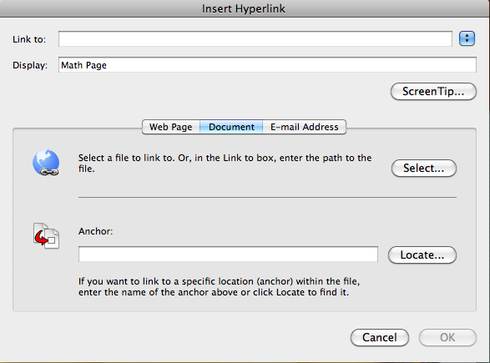
Delete box or call out text or list of services goes here
PowerPoint Hyperlinking
Strictly Students
How To Hyperlink in PowerPoint - MAC
To hyperlink using an Apple MAC, you first have to have the slide created that you want to link to. Then you highlight the word, picture, whatever you want the viewer to click on to go to the slide you want to link. Then you will right click on what you highlighted. This will bring up a box that looks like this:
You will click on “Document” then click on “Locate” beside the “Anchor”. Then you will be given a box to choose your Slide number to link to.
HOME

Slide 5
PowerPoint Hyperlinking
Proud Parents
HOME

Slide 6
PowerPoint Hyperlinking
Math Magic
Back to Math

Slide 7
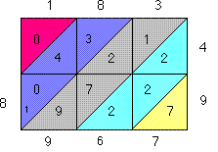
PowerPoint Hyperlinking
Lattice Math
Back to Math

Slide 8
PowerPoint Hyperlinking
Life Math
Back to Math

